Slide 1










Provable Multicore Schedulers with Ipanema: Application to Work-Conservation
Baptiste Lepers Redha Gouicem Damien Carver Jean-Pierre Lozi Nicolas Palix Virginia Aponte Willy Zwaenepoel Julien Sopena Julia Lawall
Gilles Muller

Slide 2

Work conservation
“No core should be left idle when a core is overloaded”
Core 0
Core 1
Core 2
Core 3
Non work-conserving situation: core 0 is overloaded, other cores are idle
2/32

Slide 3
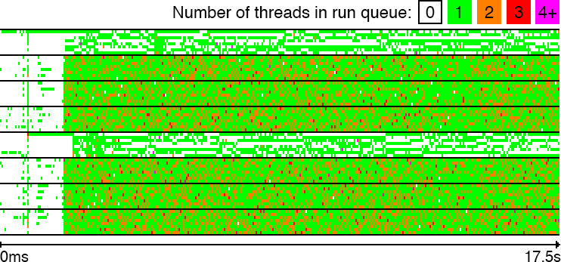
Problem
Linux (CFS) suffers from work conservation issues
0
8
16
24
32
40
48
56
Core is mostly idle
Core is mostly overloaded
Core
Time (second)
[Lozi et al. 2016]
3/32

Slide 4
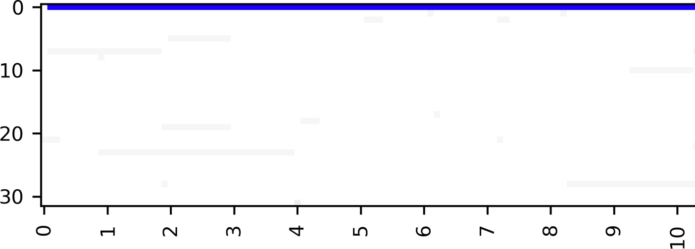
Problem
FreeBSD (ULE) suffers from work conservation issues
Core is overloaded Core is idle
Time (second)
[Bouron et al. 2018]
Core

Slide 5
Problem
Work conservation bugs are hard to detect
No crash, no deadlock. No obvious symptom.
137x slowdown on HPC applications 23% slowdown on a database.
[Lozi et al. 2016]

Slide 6


This talk
Formally prove work-conservation
6/32

Slide 7
Work Conservation Formally
(∃c . O(c)) ⇒ (∀c′ . ¬I(c′))
If a core is overloaded, no core is idle
Core 0
Core 1

Slide 8
Work Conservation Formally
(∃c . O(c)) ⇒ (∀c′ . ¬I(c′))
If a core is overloaded, no core is idle
Does not work for realistic schedulers!
Core 0
Core 1

Slide 9
Challenge #1
Concurrent events & optimistic concurrency

Slide 10



Challenge #1
Concurrent events & optimistic concurrency
Observe (state of every core)
Lock (one core – less overhead)
Act (e.g., steal threads from locked core)
Based on possibly outdated observations!
time

Slide 11

Challenge #1
Concurrent events & optimistic concurrency
Core 0
Core 1
Core 2
Core 3
Runs load balancing

Slide 12

Challenge #1
Concurrent events & optimistic concurrency
Core 0
Core 1
Core 2
Core 3
Observes load (no lock)
12/32

Slide 13


Challenge #1
Concurrent events & optimistic concurrency
Ideal scenario: no change since observations
Core 0
Core 1
Core 2
Core 3
Locks busiest
13/32

Slide 14
Challenge #1
Concurrent events & optimistic concurrency
Possible scenario:
Core 0
Core 1
Core 2
Core 3
Locks “busiest”
Busiest might have no thread left! (Concurrent blocks/terminations.)
14/32

Slide 15

Challenge #1
Concurrent events & optimistic concurrency
Core 0
Core 1
Core 2
Core 3
(Fail to) Steal from busiest

Slide 16
Challenge #1
Concurrent events & optimistic concurrency
Observe Lock
Act
Based on possibly outdated observations!
Definition of Work Conservation must take
concurrency into account!
time

Slide 17
Concurrent Work Conservation Formally
Definition of overloaded with « failure cases »:
∃c . (O(c) ∧ ¬fork(c) ∧ ¬unblock(c) …)
If a core is overloaded
(but not because a thread was concurrently created)

Slide 18
Concurrent Work Conservation Formally
∃c . (O(c) ∧ ¬fork(c) ∧ ¬unblock(c) …)
⇒
∀c′ . ¬(I(c′) ∧ …)

Slide 19

Challenge #2
Existing scheduler code is hard to prove
Schedulers handle millions of events per second
Historically: low level C code.

Slide 20
Challenge #2
Existing scheduler code is hard to prove
Schedulers handle millions of events per second
Historically: low level C code.
Code should be easy to prove AND efficient!

Slide 21
Challenge #2
Existing scheduler code is hard to prove
Schedulers handle millions of events per second
Historically: low level C code.
Code should be easy to prove AND efficient!
⇒
Domain Specific Language (DSL)

Slide 22
DSL advantages
Trade expressiveness for expertise/knowledge:
Robustness: (static) verification of properties Explicit concurrency: explicit shared variables Performance: efficient compilation

Slide 23
DSL-based proofs
 | WhyML code
 | C code
Proof
DSL Policy
Kernel module
DSL: close to C
Easy learn and to compile to WhyML and C
23/32

Slide 24
DSL-based proofs
Proof on all possible interleavings

Slide 25
DSL-based proofs
Core 0
Proof on all possible interleavings
Split code in blocks
(1 block = 1 read or write to a shared variable)
load balancing
time
load balancing

Slide 26
DSL-based proofs
Core 0
Core 1
… Core N
Proof on all possible interleavings
Split code in blocks
(1 block = 1 read or write to a shared variable)
Simulate execution of concurrent blocs on N cores
Concurrent WC must hold at the end of the load balancing
load balancing
terminate
time
fork
load balancing
fork
fork

Slide 27
DSL-based proofs
Core 0 Core 1 … Core N
Proof on all possible ^{load balancing}
interleavings
terminate
Split code in blocs fork
shared variable) time _{load balancing}
(1 bloc = 1 read or write to a
Simulate execution of concurrent _{fork}
blocs on N cores
Concurrent WC must always hold! ^{fork}
27/32
DSL ➔ few shared variables ➔ tractable

Slide 28
Evaluation
CFS-CWC (365 LOC)
Hierarchical CFS-like scheduler
CFS-CWC-FLAT (222 LOC)
Single level CFS-like scheduler
ULE-CWC (244 LOC)
BSD-like scheduler

Slide 29
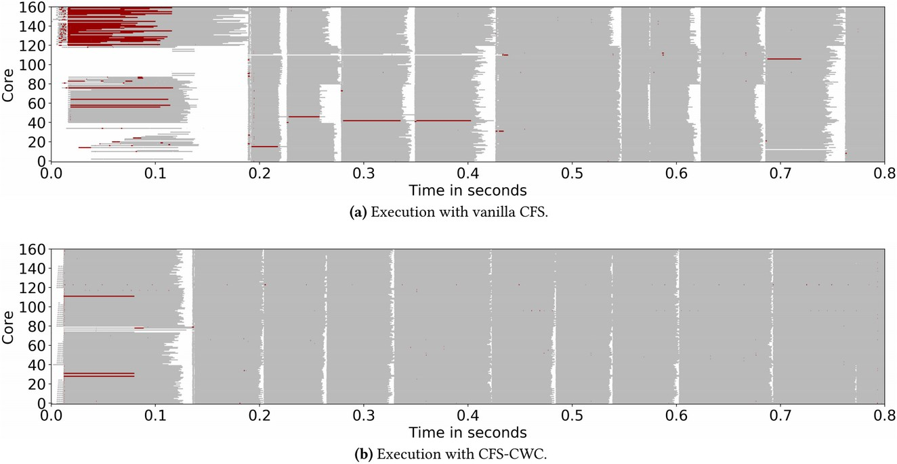
Less idle time
FT.C (NAS benchmark)

Slide 30
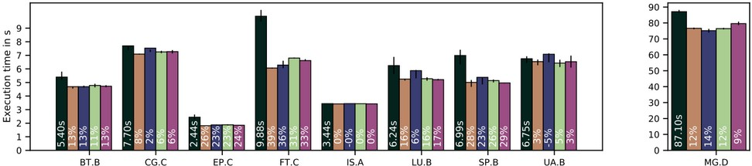
Comparable or better performance
NAS benchmarks (lower is better)

Slide 31
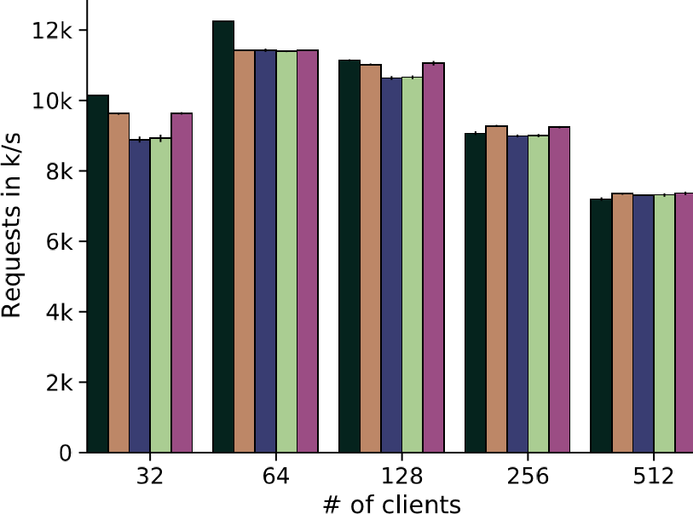
Comparable or better performance
Sysbench on MySQL (higher is better)

Slide 32
Conclusion
Work conservation: not straighforward!
… new formalism: concurrent work conservation!
Complex concurrency scheme
…proofs made tractable using a DSL.
Performance: similar or better than CFS.

